Slide 1
Unit 3- Logical Mobility
Mobile Computing
By : Prof. Ankita Nagmote

Slide 2
Contents
Process Migration, Steps, Advantages and Application
Mobile Agents
Mobile Agents Characteristics
Requirements of Mobile Agents
Mobile Agent Platform

Slide 3
What is Logical Mobility?
Logical Mobility refers to the ability to move software components, code, or computational elements between different devices or systems. This includes:
The movement of:
Software programs and applications
Code segments or modules
Objects and data structures
Computational processes
For example, when you download an app from an app store to your phone, that's logical mobility in action. Similarly, when a web browser downloads and executes JavaScript code from a server, that's also logical mobility.

Slide 4
Process Migration
Process- Program under execution
Process Migration is the transfer of a process from one computing system to another during its execution. It involves moving the entire process state, including code, data, and execution context, from a source machine to a destination machine.
Example – a person watching a movie on smart TV and want to continue watching on a tablet while moving/travelling
Communicating Process
Migrating Process
(Source Instance)
Migrating Process
(Destination Instance)
State Transfer
Source node
Destination Node

Slide 5
Process migration
The transferred state includes
the process’s address space
Execution Point( Register Contents)
Communication State( Open files and message channels)
OS-dependent states
During migration two instances of the migrating process exist: source instance and destination instance.
After migration destination instance becomes migrated process
A process running on another machine is called remote process.

Slide 6
Steps in process migration
These steps are shown pictorially in Figures below
A migration request is issued to a remote node
A process is detached from its source node
Communication is temporarily redirected
The process state is extracted
A destination process instance is created
State is transferred and imported into a new instance
Some means of forwarding references maintained
The new instance is resumed
These steps are shown pictorially in Figures below

Slide 7
1. A migration request is issued to a remote node After negotiation, migration has been accepted.
External Communication
Process X
Migration Request
Negotiation
Kernel
Kernel
Source Node
Destination Node
Migration Acceptance

Slide 8
2-A process is detached from its source node by suspending its execution, declaring it to be in a migrating state, and temporarily redirecting communication as given in the following step.
External Communication
Process X
Detached Process
Kernel
Kernel
Source Node
Destination Node

Slide 9
3.Communication is temporarily redirected by queuing up arriving messages directed to the migrated process. These are delivered to the process after migration.
External Communication
Process X
Detached Process
Kernel
Kernel
Source Node
Destination Node

Slide 10
4.The process state is extracted which includes its memory contents, processor state (register contents), communication state (e.g., opened files and message channels) and relevant kernel context.
External Communication
Process X
Detached Process
Kernel
Kernel
Source Node
Destination Node

Slide 11
5-A destination process instance is created into which the transferred state will be imported.
External Communication
Process X
Detached Process
Kernel
Kernel
Source Node
Destination Node

Slide 12
6-State is transferred and imported into a new instance on the remote node. All of the state need not be transferred at once.
External Communication
New Process
Process X
Detached Process
Transfer State
(code, data, register, etc)
Kernel
Kernel
Source Node
Destination Node

Slide 13
7.Some means of forwarding references
External Communication
Forwarding Reference
New Process
Process X
Kernel
Kernel
Source Node
Destination Node

Slide 14
8.The new instance is resumed
External Communication
Forwarding Reference
New
Process
Process
X
Kernel
Kernel
Source Node
Destination Node

Slide 15
Advantages of process migration
Dynamic load distribution
To balance the load by migrating processes from overloaded nodes to less loaded ones
Fault resilience
By migrating processes from nodes that may have experienced a partial failure or are likely to fail completely
Improved system administration
Migrating processes from the nodes that are about to be shut down or made unavailable

Slide 16
Advantages of process migration
Data access locality
Migrating process to closer to the source of data as the user moves from one network or cell to another
Resource sharing
Possible on a grid, by migration of a process to a specific node that is equipped with a special hardware device
Mobile computing
Users may want to migrate running applications from a host to their mobile computer as they connect to a network at their current location

Slide 17
Applications of process migration
Parallelizable applications
Long-running applications
Generic multiuser workloads
A pre-emptable application
Migration-aware applications
Network and mobile computing applications

Slide 18
Applications of process migration
Self - study

Slide 19
Alternatives to process migration
Remote execution
Invocation of some code on a remote node
Faster than migration bcoz of cost of transferring a large process state.
Cloning
Useful in cases where the child process inherits state from the parent process
Achieved using remote fork mechanism
Complexity similar to migration
Migration parent is terminated but cloning both run using distributed shared state
Mobile agents
Using Java and Tcl/Tk
Object migration at the middleware level
Common request broker architecture(CORBA)
Distributed objects

Slide 20
TYK
Which one of the following is called a ‘process’?
Program in execution
Code
State specific to underlying operating system
Object
Which one of the following is not a component of the system process’s kernel in a distributed operating system?
Command interpreter
Process manager
Memory scheduler
File manager

Slide 21
TYK
Which one of the following is an instance of a migrated process?
Destination instance
Remote instance
Correspondent instance
Source instance
Which one of the following is not a step in process migration?
Process is detached from its source node
State is transferred and imported into a new instance on the remote node
Migration request is issued to a source node
Destination process instance is created

Slide 22
Mobile AGENTS
Mobile Agents are the composition of computer software and data that can autonomously move from one computer to another computer and continue its execution on the destination computer.
Mobile Agents are the pieces of codes that are used to store data and are independent in nature i.e. they are self-driven and does not require corresponding node for communication as they are capable of functioning even if user gets disconnected from the network.
They are also called as transportable agents.
They can be broadly classified into two types:
Agents with pre-defined path.
Agents with undefined path i.e. Roamer.

Slide 23
What are mobile agents
An agent is a software object that is situated within an execution environment. It possess the following mandatory properties
Reactive - senses changes in the environment and acts in accordance with those changes
Autonomous - has control over its own actions
Goal-driven - is pro-active
Temporally continuous - executes continuously and may possess one or more of the following orthogonal properties:
Communicative- can communicate with other agents
Mobile - can travel from one host to another
Learning - adapts in accordance with previous experience

Slide 24
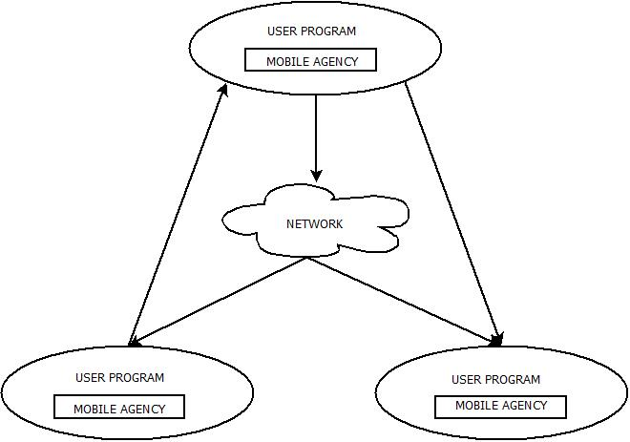
Mobile agent
The life-cycle of these agents ensures that they are :
Able to adapt the environment i.e. either home or foreign environment.
Able to switch among the positions of one node to other.
Focused towards the final output.
Autonomous.

Slide 25
Mobile agent platforms
Mobile agent systems use specialized servers to interpret the agent's behavior and communicate with other servers.
A mobile agent has inherent navigational autonomy and can ask to be sent to some other nodes.
It should be able to execute on every machine in a network and the agent code should not have to be installed on every machine the agent could visit.
Mobile agents use mobile code systems like Java and the Java virtual machine where classes can be loaded at runtime over the network.
Mobile agents may be one-hop, that migrate to one other place only, or multi-hop that roam the network from place to place.

Slide 26
Mobile agent components
A mobile agent is composed of two different pieces.
One piece is the code itself, which consists of the instructions that define the behavior of the agent.
The second piece is the current state of execution of the agent. Often, these two pieces are separate. For example, in a typical computer program, the code sits on disk while the executing state sits in RAM. A mobile agent, however, brings the two together.

Slide 27
Mobile agent components
When an agent migrates to a new host, both its code and its state are transferred. Thus, the agent does not only remember what to do and how to do it, it remembers what it was doing before as well.
When an agent migrates to a new host, both of these pieces must be captured and packaged.

Slide 28
Characteristics of Mobile Agents
An agent must have its own unique identity.
It must be able to determine what other agents are executing on the agent host.
It must be able to determine what messages other agents accept and send.
An agent host must allow agents to communicate with each other and itself.
It must allow multiple agents to co-exist and execute simultaneously.

Slide 29
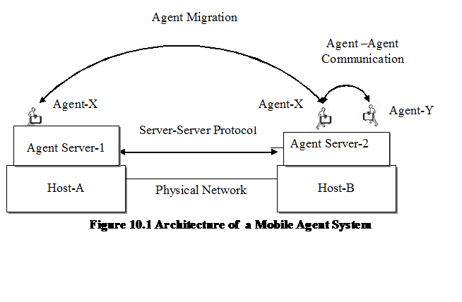
Agent Architecture

Slide 30
Mobile Agents and Process Migration
Aspect | Mobile Agents | Process Migration
Control | Autonomous decision-making; agents decide when and where to move | System-controlled; OS or network manager decides movement
Intelligence | Built-in intelligence to make decisions; can adapt behavior | No built-in intelligence; follows system instructions
Decision Basis | Moves based on programmed objectives and current needs | Moves based on system load and resource availability
Flexibility | Can change destinations dynamically; multiple-hop capable | Fixed source-to-destination movement; single-hop
State Management | Carries both code and state together as a package | State must be captured, transferred, and reconstructed
Interaction | Can communicate with other agents and systems | No inter-process communication during migration

Slide 31
Client/server and mobile agent architectures
Mobile agents solve the client/server network bandwidth problem. By moving a query or transaction from the client to the server, the repetitive request/response handshake is eliminated.
Agent architectures also solve the problems created by intermittent or unreliable network connections. Agents can be built quite easily that work “off-line” and communicate their results back when the application is “on-line”.

Slide 32
Requirements for Mobile Agent Systems
Portability
Ubiquity
Network Communication
Server Security
Agent Security
Resource Accounting

Slide 33
Mobile agent platforms: AGLETS
Aglets are a java-based framework for mobile agents, designed by IBM.
With Aglets one can construct objects that can move from one host on the network to another, i.e. an Aglet that executes on one host can suddenly halt execution, dispatch to a remote host and start executing again.
When the Aglet moves, it takes along its program code as well as the states of all the objects it is carrying.

Slide 34
The Aglet context
A context is an Aglet’s workplace.
It is a stationary object that provides a means for maintaining and managing running Aglets in a uniform execution environment.
One node in a computer network may host multiple contexts.
User
Aglet
Aglet
Aglet Proxy
Aglet Proxy
Aglet Context
Aglet
Aglet
Aglet Proxy
Aglet Proxy
Aglet Context
Engine
Host

Slide 35
The Aglet context
A proxy is a representative of an Aglet.
Serves as a shield for the aglet
Protects it from direct access to its public methods.
The proxy also provides location transparency for the Aglet. That is, it can hide the real location of the Aglet.
User
Aglet
Aglet
Aglet Proxy
Aglet Proxy
Aglet Context
Aglet
Aglet
Aglet Proxy
Aglet Proxy
Aglet Context
Engine
Host

Slide 36
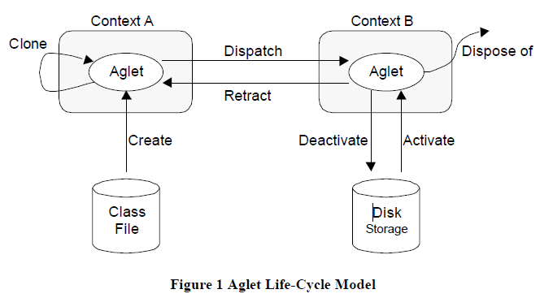
Aglet Life cycle
The creation of an Aglet takes place in a context. The new Aglet is assigned an identifier, inserted in the context, and initialized. The Aglet starts executing as soon as it has successfully been initialized.

Slide 37
Aglet Life cycle
The cloning of an Aglet produces an almost identical copy of the original Aglet in the same context. The only differences are the assigned identifier and that the execution restarts in the new Aglet.

Slide 38
Aglet Life cycle
Dispatching an Aglet from one context to another will remove it from its current context and insert it into the destination context, where it will restart execution (execution threads will not migrate). We say that the Aglet has been pushed to its new context.

Slide 39
The retraction of an Aglet will pull (remove) it from its current context and insert it into the context from which the retraction was requested.
The deactivation of an Aglet is the ability to temporarily remove it from its current context and store it in secondary storage. Activation of an Aglet will restore it in a context.
The disposal of an Aglet will halt its current execution and remove it from its current context.

Slide 40
Aglet communication
Aglets use messages and events for communication and interactions.
Message communication can be either synchronous or asynchronous.
Events can be used for either reactive or proactive agents, for example, an Aglet agent can listen for some event such as a change in stock value.
Aglet API is a Java package consisting of classes and interfaces, viz., aglet, Aglet Proxy, Aglet context & message.
Application: Aglets have been applied in various scenarios, including ecommerce, the e-market place, for air-tickets and package tours.

Slide 41
Aglet Event Model
The aglet programming is event based. Three kinds of listeners exist:
Clone listener
Mobility listener
Persistence listener

Slide 42
Aglet Event Model
Clone listener :
Take specific actions when an aglet is about to be cloned, when the clone is actually created, and after the cloning take place.
Mobility listener:
To take action when aglet is about to be dispatched to another context, when it is about to retracted from a context, and when it actually arrives in a new context.

Slide 43
Aglet Event Model
Persistence listener:
Allows the programmer to take action when an aglet is about to be deactivated and after it has been activated.

Slide 44
Thank You

